Slide 1
Analyzing what features affect housing price in Beijing
Presented by Advaith Kamath, Nahnsan Guseh, Junqi Qian

Slide 2
Statement and goal
Dataset : Housing price in Beijing
- Housing price of Beijing from 2011 to 2017, fetching from Lianjia.com
Goal:
- Analyzing what variables affect housing price in Beijing
- provide reasonable advice for government investment and home buyers

Slide 3
Data
Description
Factor name | Description | Data type
url | the url which fetches the data | character
id | the id of transaction | character
Lng/Lat | Lng and Lat coordinates, using the BD09 protocol | numerical
Cid | community id | numerical
tradeTime | the time of transaction | character
DOM | active days on market | numerical
followers | the number of people follow the transaction | numerical
totalPrice | the total price | numerical
price | the average price by square | numerical
square | the square of house | numerical
livingRoom | the number of living room | numerical

Slide 4
Data
description
Factor name | Description | Data type
bathroom | the number of bathroom | numerical
drawingRoom | the number of drawing room | numerical
kitchen | the number of kitchens | numerical
Floor | the height of the house | numerical
buildingType | including tower (1) , bungalow(2)，combination of plate and tower(3), plate(4) | numerical
subway | If it’s near a subway station | character
district | The district it located | character
buildingStructure | including unknow (1), mixed(2), brick and wood(3), brick and concrete(4),steel(5) and steel-concrete composite (6) | numerical
ladderRatio | the proportion between number of residents on the same floor and number of elevators of ladder. It describes how many ladders a resident has on average | numerical
elevator | have ( 1 ) or not have elevator( 0 ) | numerical
fiveYearsProperty | if the owner has the property for less than 5 years | numerical

Slide 5
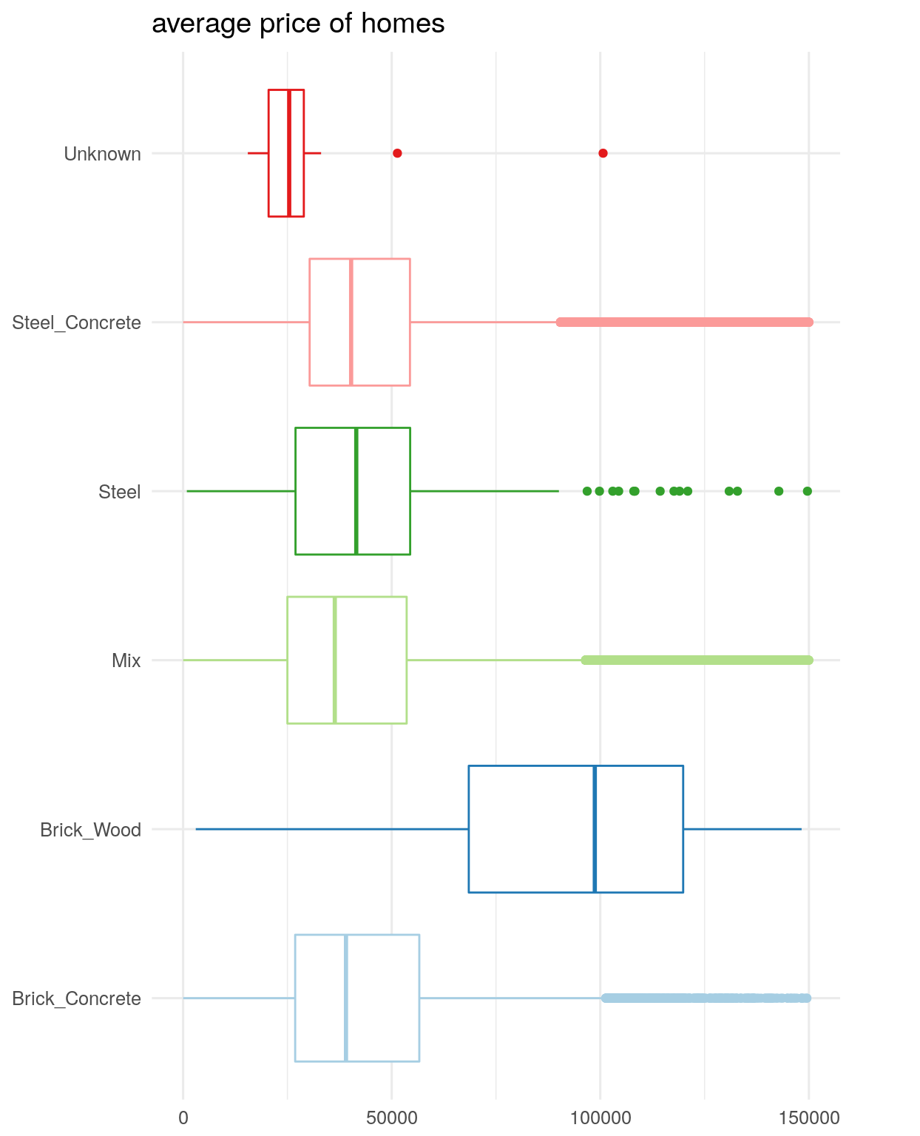
Initial Descriptive Statistics
Average Price of homes vs Building Structure
We can see that Brick wood houses have a higher average price

Slide 6
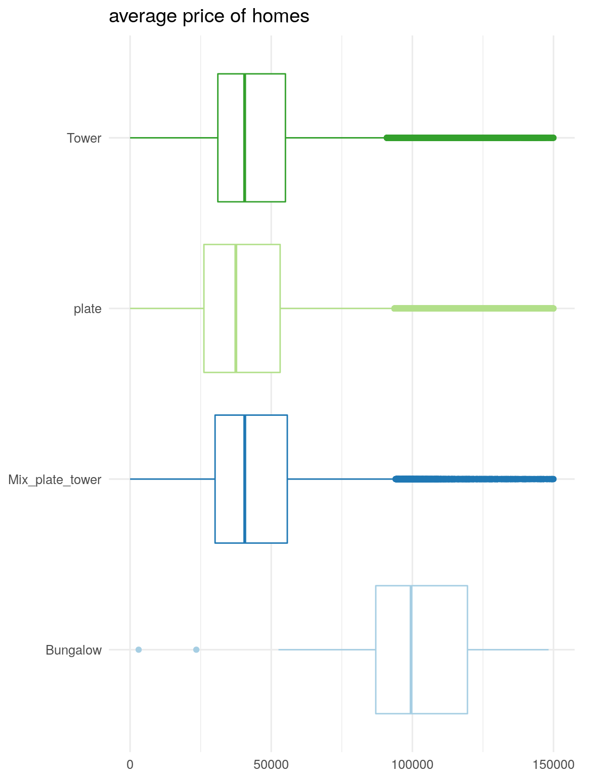
Initial Descriptive Statistics
Average Price of homes vs Building Type
We can see that Bungalows have a higher average price

Slide 7
Challenges
Large Dataset
318851 Rows of Data
26 Columns
Missing Values
Construction time
Days on the market
Community Average
Subway
Elevator
5 year property
Notes:
For yes

Slide 8
Handling Missing Values
Median of data
For all numeric values like construction time
Omit data
For true of false values like having an elevator if it’s a 5 year property
The True or False (1 & 0) values are not missing as much data

Slide 9
Tentative Solution
Association Rule Mining
Analysing all the attributes that affect the “totalPrice” by varying the support and confidence values
Clustering
By creating clusters based on communities we can know which community reports higher sales in terms of the total price and the count
Decision Tree
By creating a decision tree we can find out which factors affect the total price

Slide 10
Evaluation Methods
Hold Out Test
We are thinking of splitting the data 2:1 to evaluate the results of the Decision Tree Analysis
Cross Validation
For a dataset of this volume, the value of N is taken to be 10

Slide 11
Thank You

